Slide 1
Programming for graphics
Introduction

Slide 2
Before we start!
Sorry for any bad spelling.
Dyslexia Sukcs…..

Slide 3
Where is computer graphics used

Slide 4
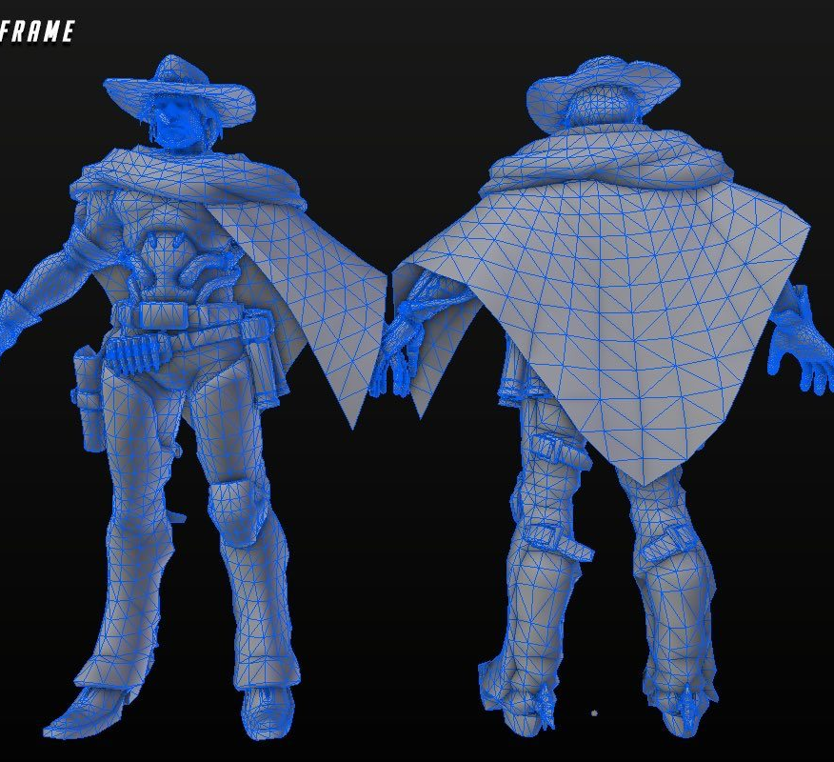
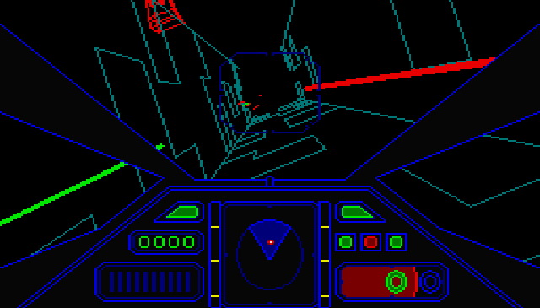
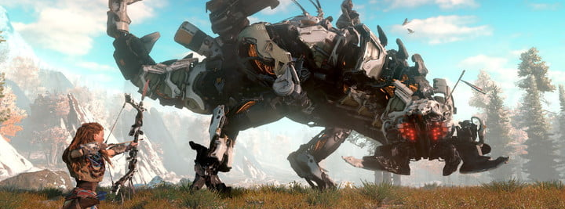
Notes:
What we are interested in
GAMES!!!

Slide 5
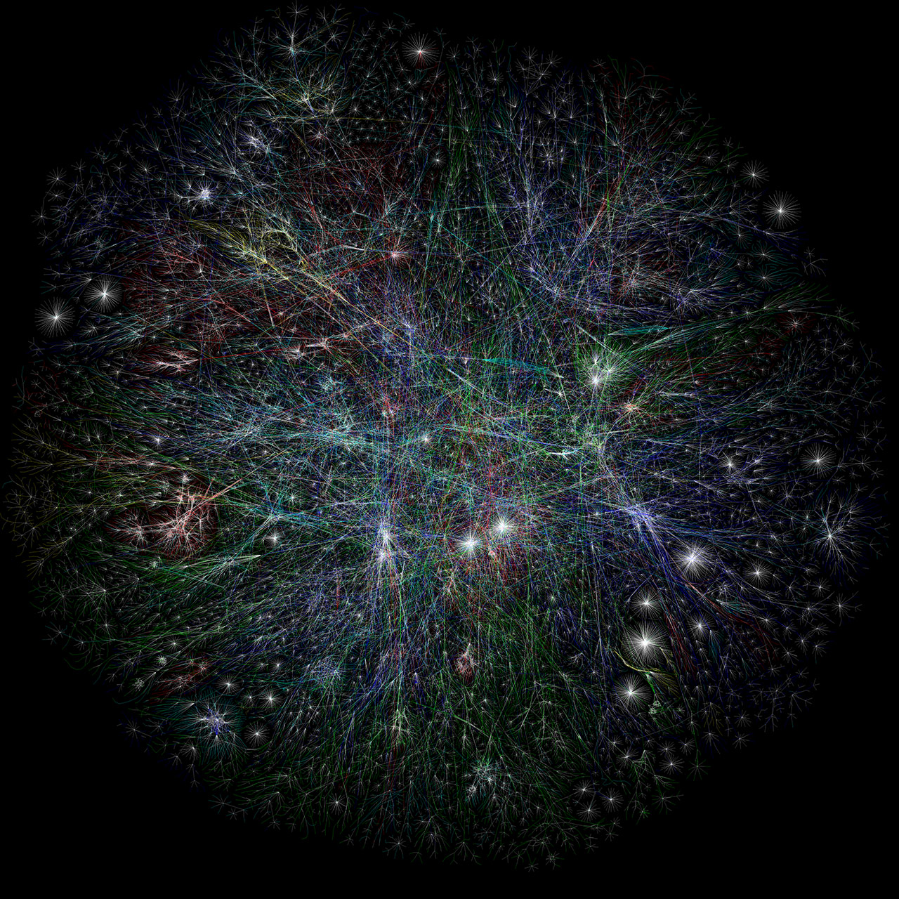
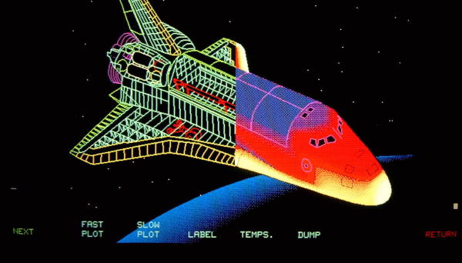
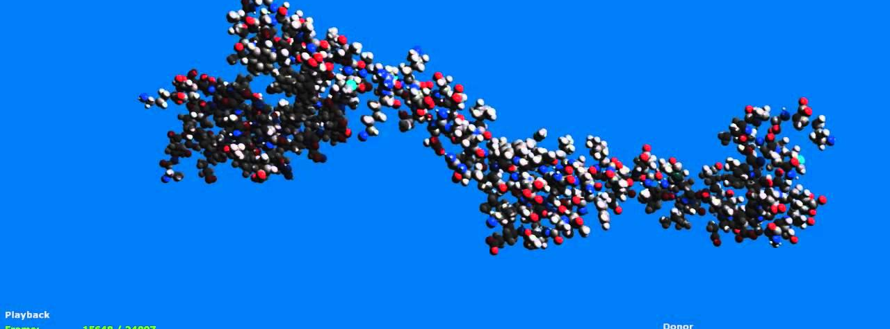
Notes:
Simulations
Want to see stress tolerance of space shuttle?
How to fold proteins ?
Map of the internet?

Slide 6
One of my favourite Visualizations: https://earth.nullschool.net/

Slide 7
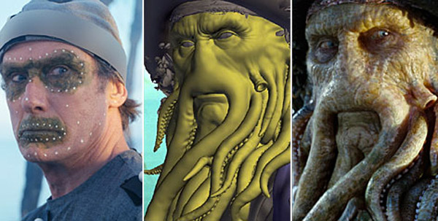
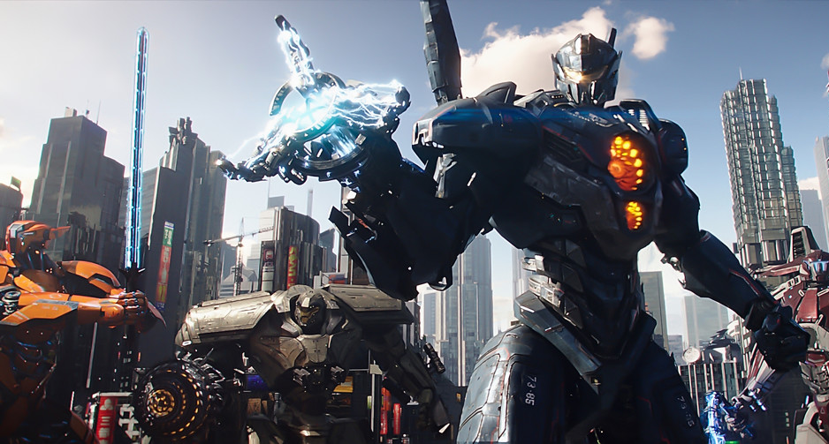
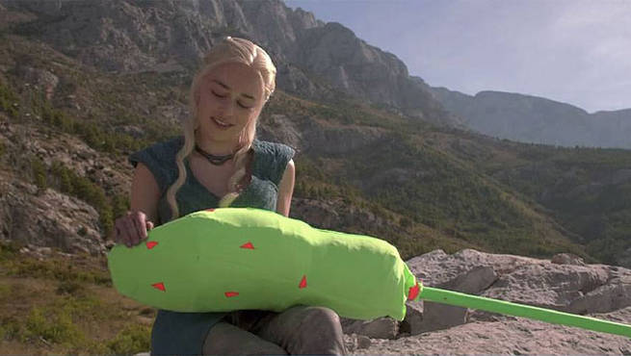
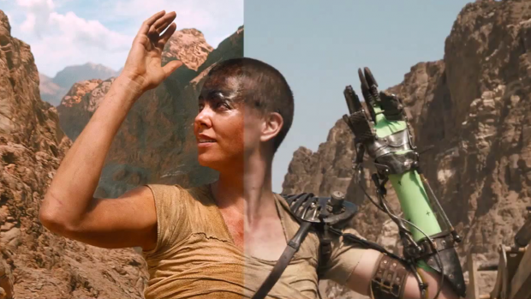
Notes:
Used in film
Used to replace actors with squids
Add Dragons where there were no dragons before
Remove persons hand with out resorting to surgery (even add a background or 2) and give Nick a moment of happiness when we sees giant robots beating the stuffing out of giant monsters :p

Slide 8
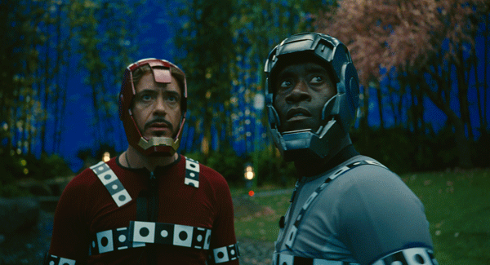
Notes:
Once you know how it works, you favourite films will seem less impressive ☹

Slide 9
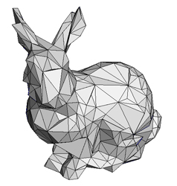
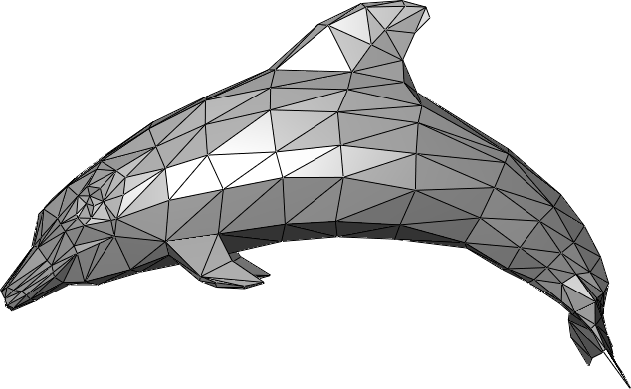
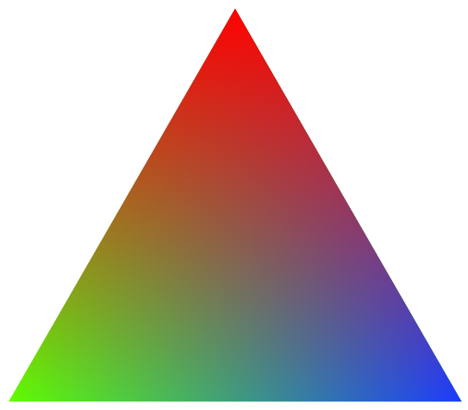
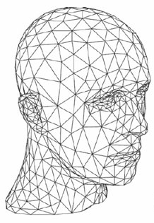
Humble beginnings
Used to generate images from data
Usual 3D models
Triangles!
Notes:
We use triangle, lost of triangles
As we all know, triangles are made up of 3 POINTS.
These points are connected together with LINES.
These line define a SURFACE.
Using points, lines and surfaces we can make representations of dolphins, head, rabbits….

Slide 10
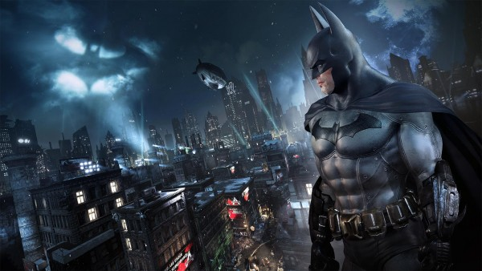
Notes:
Or batman!

Slide 11
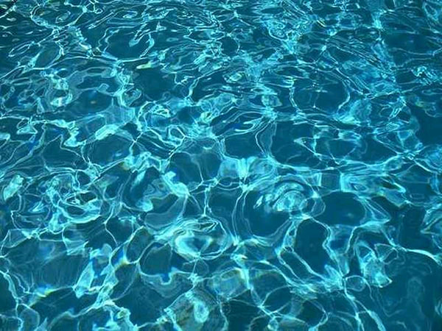
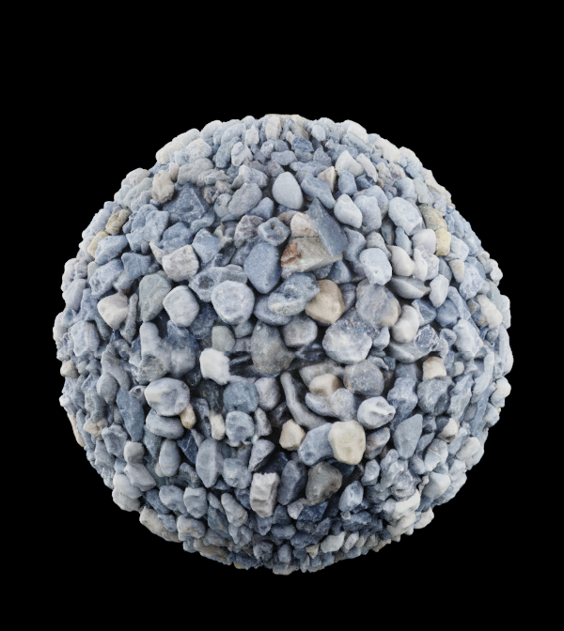
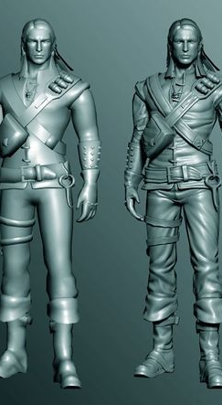
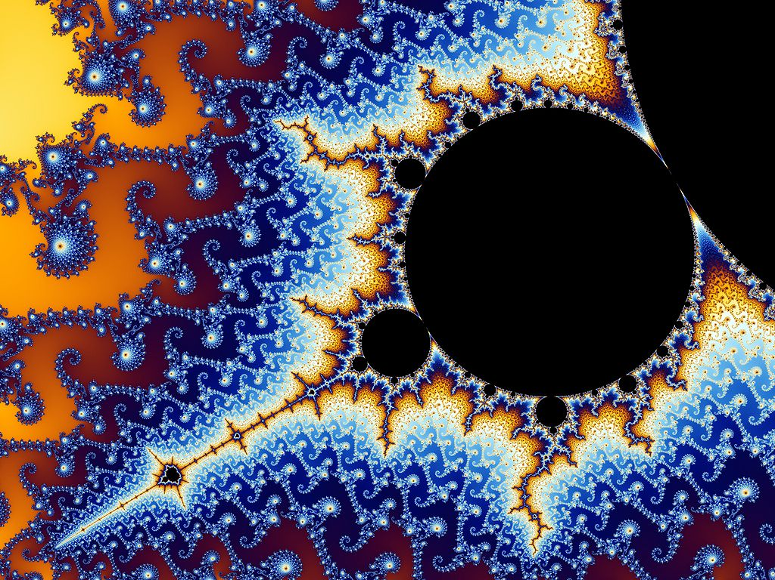
More than just triangles
Used to generate images from data
Not just 3D models !
No triangles needed
Notes:
Computer graphics is about more than just triangles.
We can use graphics to represent obscurer mathematical concepts like the mandelbroguht set.
We use computer to generate some thing that is infinitely complex and then use computer graphics to make it look pretty.
We can also manipulate colour directly to simulate water caustics.
How do we add extra detail to characters with out using more triangles?
How do we add more detail to objects like the stones in the top right corner?

Slide 12
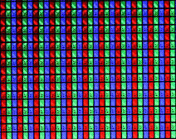
PixEls!
Notes:
Its always pixels.
Everything we do will be resolved to pixels
Keep this in mind all the time.
3D graphics is the art of turning sets of 3 numbers in to coloured squares on your screen.

Slide 13
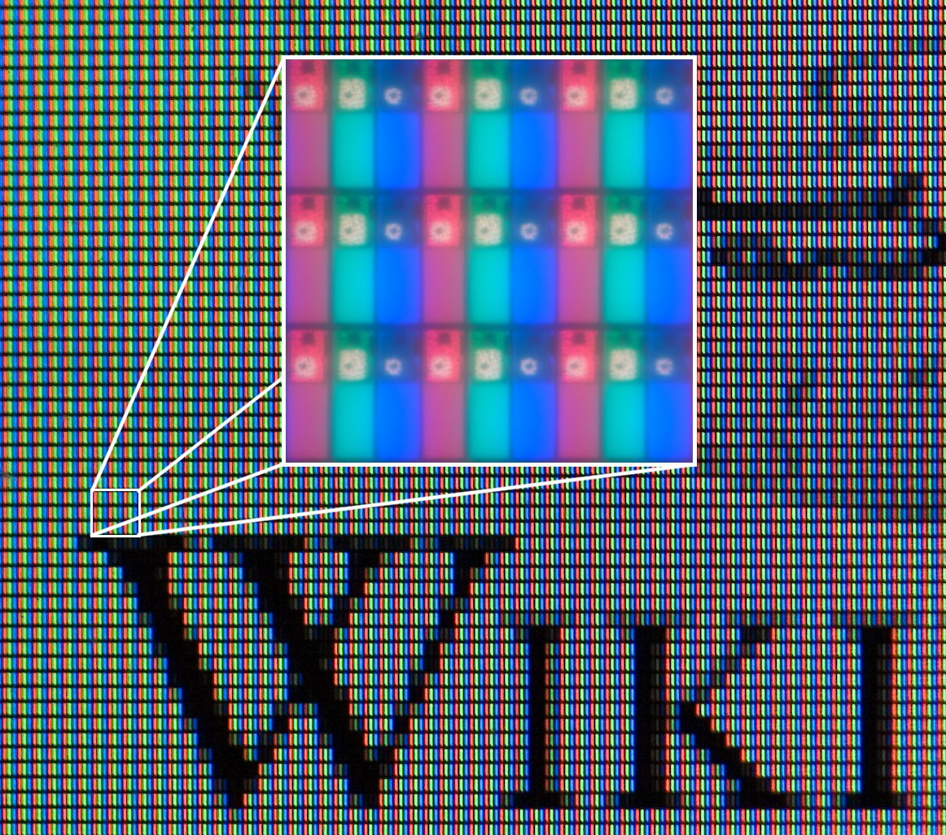
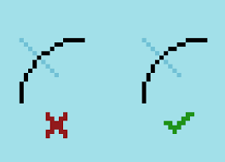
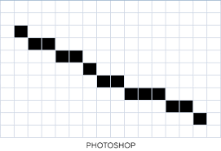

Notes:
Everything we will be doing is simply a way to very the amount of light emitted from a screen at a given point.

Slide 14
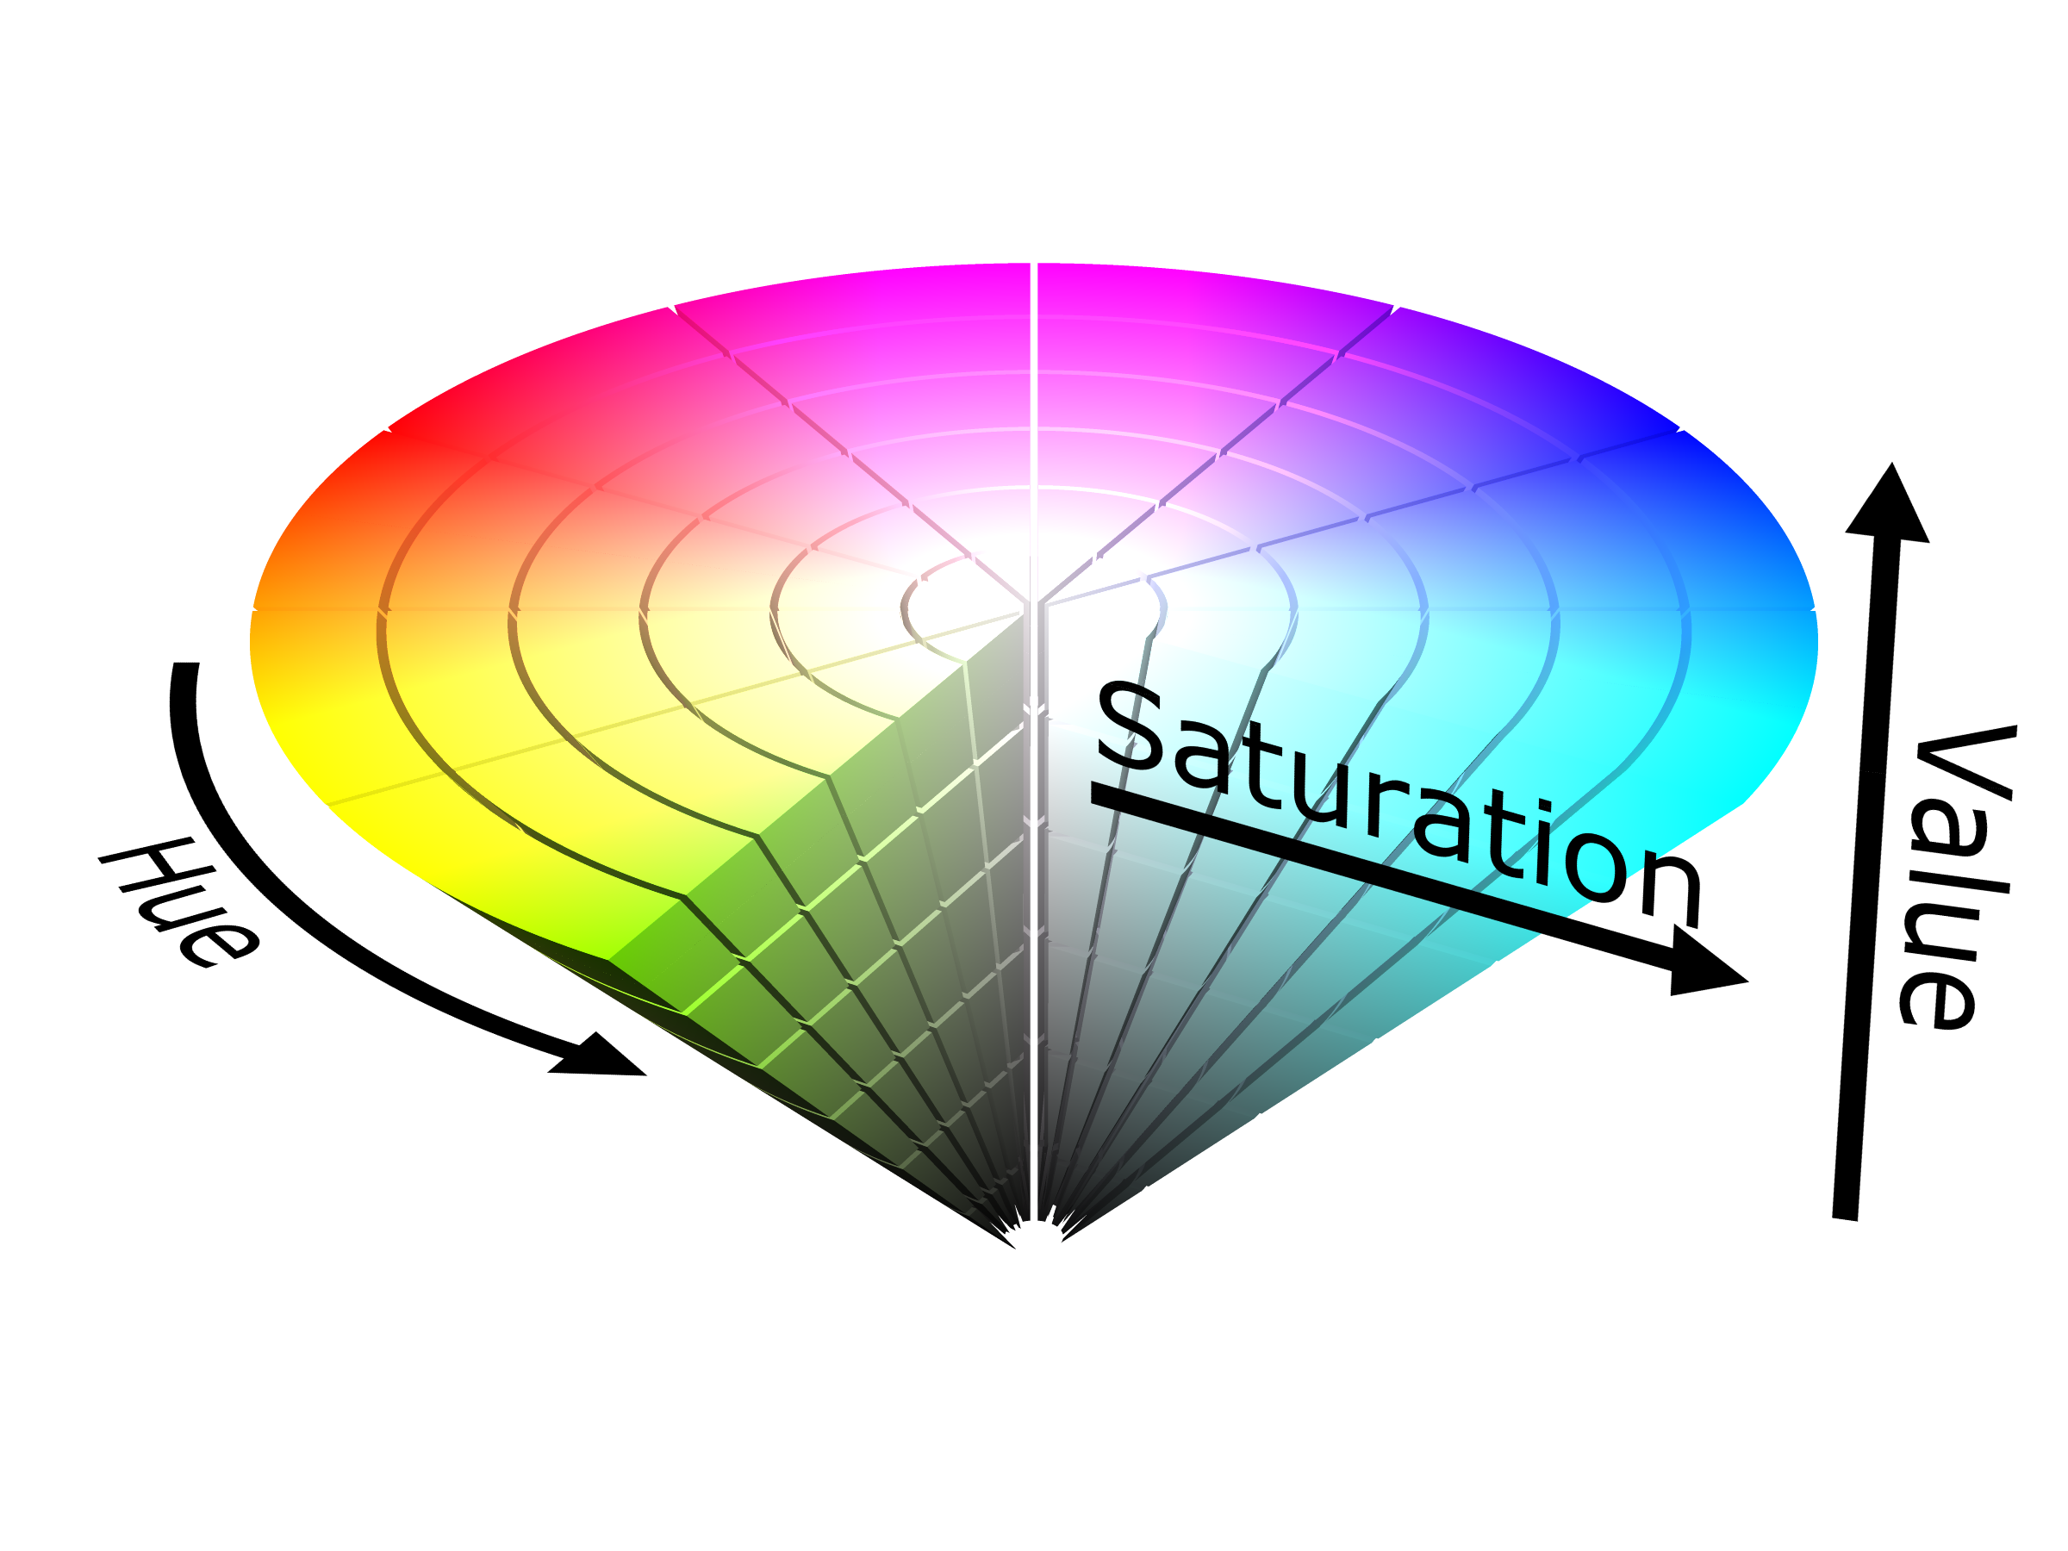
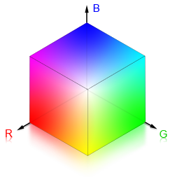
Color space
Notes:
Lets take a second and talk about how we represent colour in computers.
We call these representations, Colour spaces.

Slide 15
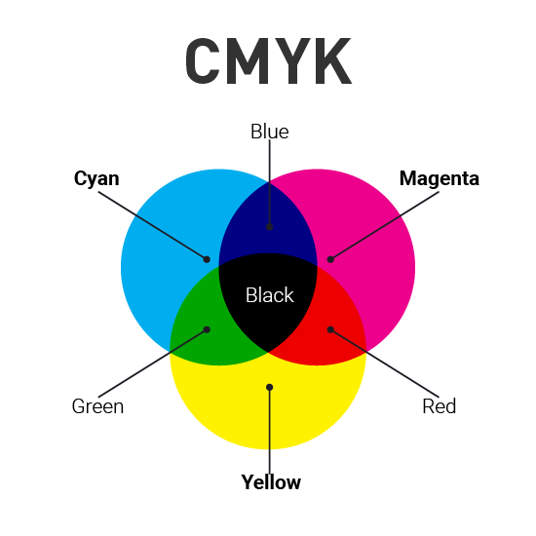
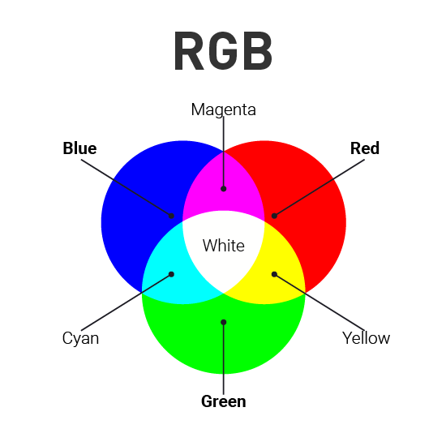
Notes:
There are several colour spaces
RGB is an additive system (monitors use it)
CMYK is a subtractive system and use in the print industry

Slide 16
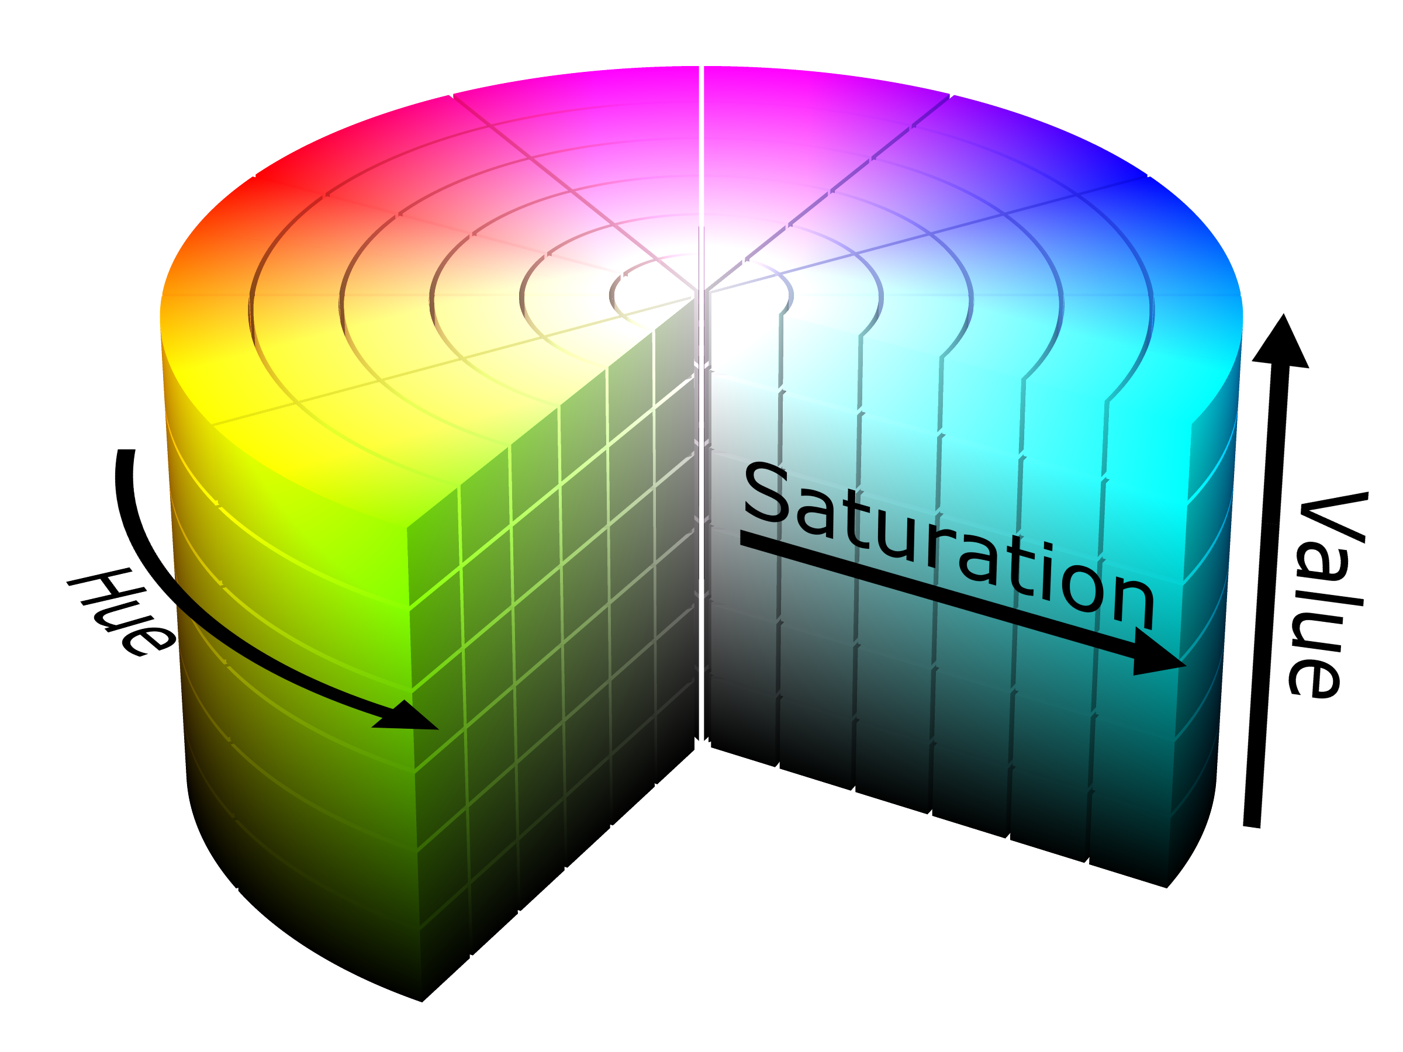
Notes:
HSV is an alternative way of representing colour on computers
Artists tend to prefer HSV as they tend to understand colour values in HSV more intuitively than RGB

Slide 17
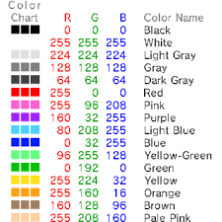
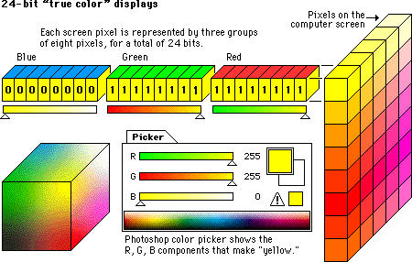
Notes:
We use RGB as screens are made up of red green blue LED’s and a backlight to illuminate them.
So 3 numbers to represent R G B is more useful for us
But we can convert to other colour space if we wanted to. But we wont.
All the, red, green and blue LEDs + back light = white
And no RGB + back light = black
All RGB values can be represents with 3 values between the range of 0 and 255 (making 256 possible values, or a char)
Some RGB representations will use separate numbers for each value.
Some will smash the values together in to on number and will retrieve the colour channel we want by bit masking and bit shifting.

Slide 18
This unit

Slide 19
In this unit you will:
Demonstrate an understanding of computer graphics concepts.
Implement a computer application to a specified brief demonstrating a range of graphics techniques.
Demonstrate an ability to implement shaders within graphics applications.

Slide 20
Assignments
Assignment 1
Graphics primitives
Transformations
Movable Cameras
Shaders
Assignment 2
Lighting
Loading texture files
Loading 3D models
Textured meshes
Notes:
2 assessments
Each will contain a computer program that will demonstrate your knowledge of the subject and each will have a 1500 word report evaluating the techniques you have implemented / alternative techniques.

Slide 21
Do not come asking for help the week before the deadline!
Its too late by then, I won't be able to help you and you would have had weeks to ask me any questions.
A failure to plan on your part is not an emergency on mine.

Slide 22
Software we will use

Slide 23
OpengGL | Direct3D | Vulkan
Open Platform | MS Win & XBOX only | Open Platform
Graphics only API | Multimedia API | Graphics only API
No game specific functions | More game specific functions | No game specific functions
3rd Party extensions | No 3rd party extensions | 3rd Party extensions
Nvidia, ATI Technologies, Matrox all support both OpenGL, Direct3D and Vulkan
Notes:
OpenGL and Vulkan are open standards from the Kronos group
Direct 3d is part of the Direct X library from Microsoft.
Vulkan and direct 3D 12 are designed to be better at asynchronous operations, shared resources, thread and memory management.
We will be using openGL
Why because Vulkan is hard and long winded, D3D is easier by locked to windows, openGL is available on all platforms and is easier.

Slide 24
SDL2
Simple DirectMedia Layer
Enables event management
Handles input for us
Makes creation of window and user interaction much easier in small to medium sized apps.
Includes all the OpenGL functions
OpenGL functions start with a prefix gl
OpenGL constants start with GL_
SDL library functions are prefixed with sdl_

Slide 25
GLEW
OpenGL Extension Wrangler
Run-time tools to determine which OpenGL extensions are supported on the target platform.
http://glew.sourceforge.net/

Slide 26
GLM
GL Mathematics library
Contains a collection of useful mathematics, classes, structs and functions for graphics

Slide 27
You will need to take notes. Get a note book!

Slide 28
Recommended reading

Slide 29
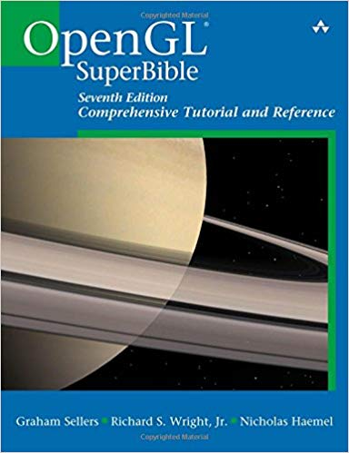
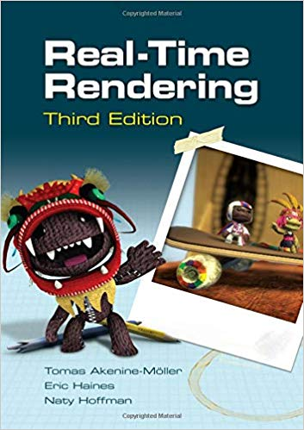
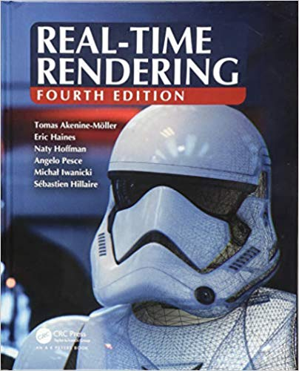
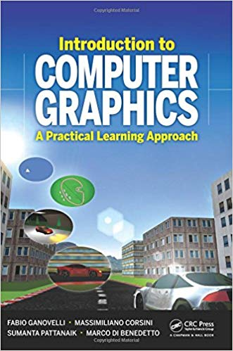
OpenGL Superbible: Comprehensive Tutorial and Reference
ISBN-10: 9780672337475
ISBN-13: 978-0672337475
Real-Time Rendering, Third / Fourth Edition
ISBN-10: 9781138627000
ISBN-13: 978-1138627000
ISBN-10: 9781568814247
ISBN-13: 978-1568814247
Introduction to Computer Graphics: A Practical Learning Approach
ISBN-10: 1439852790
ISBN-13: 978-1439852798

Slide 30
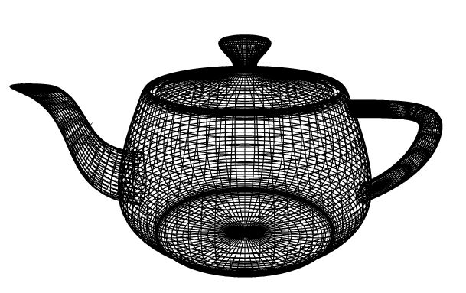
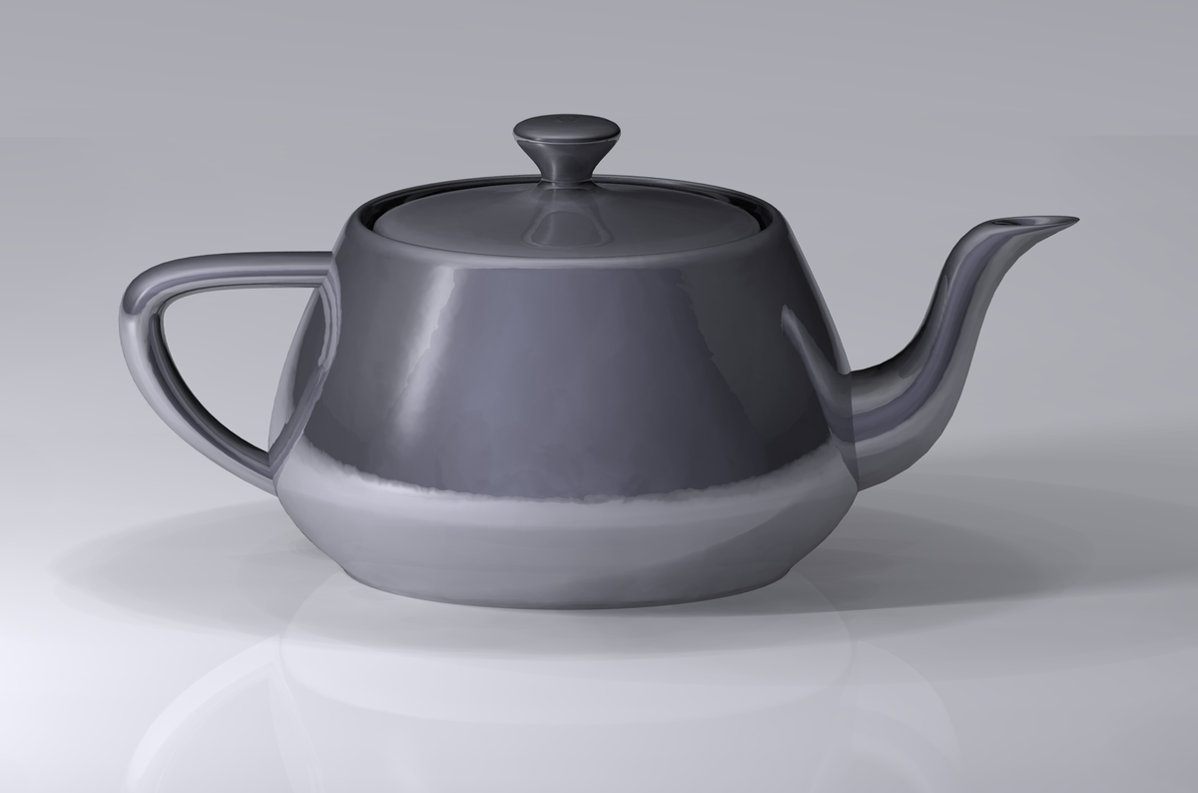
Concerning tea pots
Notes:
Because every thing is better with tea!

Slide 31
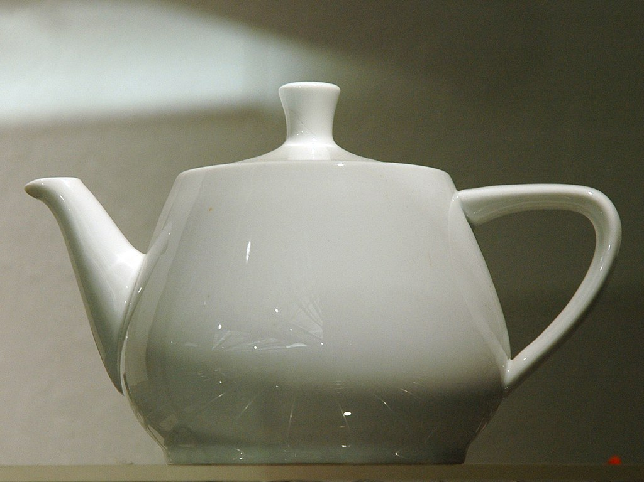
Utah teapot
or the Newell teapot
A 3D model used as a standard refence model
contains several elements making it ideal for the graphics experiments
it is round
Contained saddle points
can project a shadow on itself
can be displayed accurately without a surface texture
Notes:
Martin Newell needed a simple mathematical model of a familiar object.
His wife, Sandra Newell, suggested modelling their tea service since they were sitting down for tea at the time.
The shape was perfect for graphics research at the time.
The tea pot is round
Contained saddle points
can project a shadow on itself
can be displayed accurately without a surface texture
These days is it considered a bit of an in joke

Slide 32
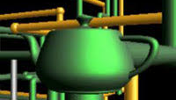
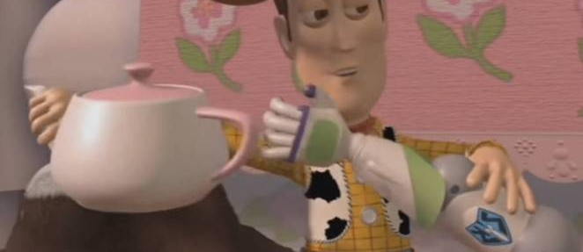
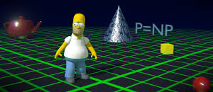
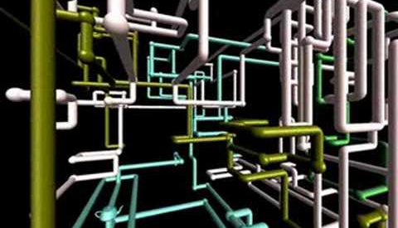
Notes:
It has appeared in several films including many pixar films. (just keep your eyes open and your bound to find it).
An episode of the Simpsons
Widows screen savers

Slide 33
Questions?

